Slide 1
Advanced Recipe
Research: Herbs

Slide 2
Grading Policy
All materials are to be done in Verdana 12 pt
All materials are to be saved and send as attachments with the following title:
Advanced <Classwork Name> < First Initial Last Name>
All materials will be turned in by the assigned deadline
Extensions will be handled on a case by case basis
Each of the above will discount Ten Points (10) from the grade of the assignment.

Slide 3
I. Research
1. Each student will be assigned a particular herb
2. The student is to research a recipe the uses that herb as a main ingredient.
3. Create a clean copy of the recipe which does not have any extraneous images or information
4. Have the hyperlink included at the top of the page from the source of the recipe.
*The link must be live for grading purposes. If the link is not Active, the recipe will be returned with a 10-point deduction and the Classwork begun again*
5. The recipe must be submitted as an attachment in email.

Slide 4
The recipe must have at least six ingredients, not counting the following:
Oil
Salt
Pepper
Water

Slide 5
a link from a hypertext file or document to another location or file, typically activated by clicking on a highlighted word or image on the screen.
This should allow me to check the original recipe from the internet

Slide 6
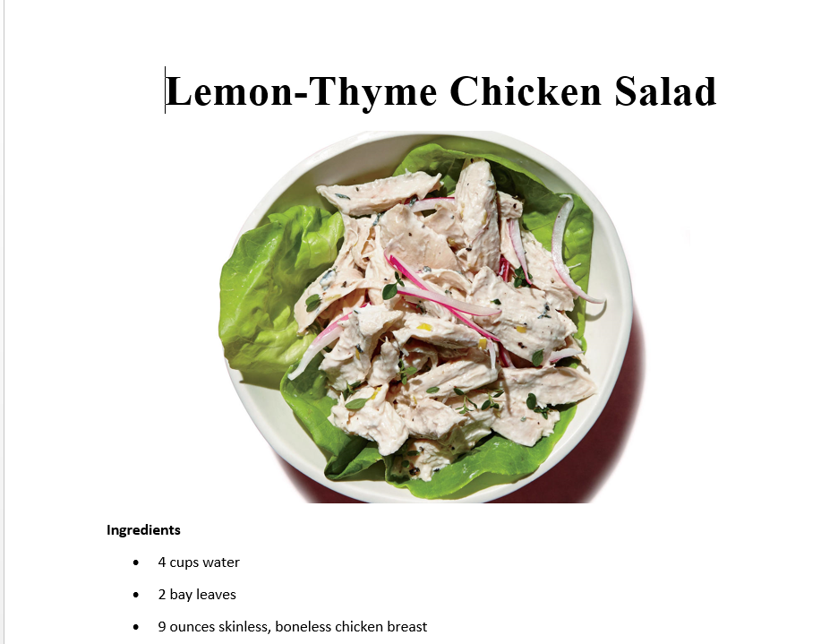

Slide 7
The recipe should include the following:
Title
Ingredients with Measurements
Directions and/or Procedures.

Slide 8
II. Organization
The recipe will then be place in the standardized recipe format.
The recipe must include the assigned herb.
The expectation is that the student should be able to place it will a modicum of editing for clarity and conciseness.
No duplicate work will be accepted.

Slide 10
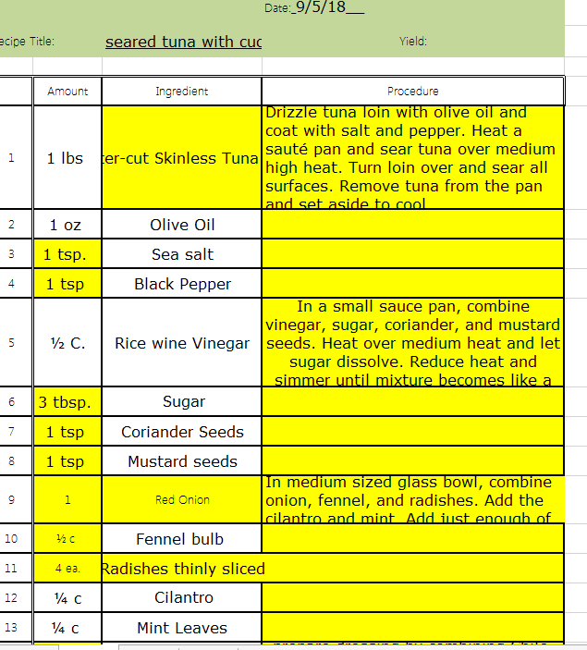

Slide 11
No Duplicate Work
The Second Part: Recipe Format
Major Grade
First part: Recipe will be due today by 4:00
Second Part: Recipe Format will be due
Thurs by 4:00

